Slide 1
Unlocking the Power of Health Information
How HIM professionals strengthen policy, planning, and performance
Notes:
Health systems around the world are investing heavily in digital tools, data platforms, and AI — but too often, they overlook the workforce that makes health information usable.
This quick presentation makes the case for investing in health information management professionals — or HIM professionals — as an essential part of high-performing health systems.
Our goal is simple: show how HIM professionals drive better data quality, stronger public health outcomes, more sustainable financing, and smarter digital transformation.

Slide 2
Health data is only as good as the professionals who make it usable
Data is growing, but still underused
70+ countries use DHIS2 at national scale — yet gaps persist in quality and interoperability
HIM professionals make health data usable
Turn raw information into records, reports, and decisions that drive better care and policy
Global digital health investments are massive
Annual spend already exceeds $67 billion, and is expected to reach $540 billion by 2036.¹ Yet these investments fall short — or fail — without a skilled HIM workforce
Notes:
As health data grows, so too do the gaps in quality and interoperability.
Fundamentally, it’s HIM professionals who make all that data usable.
As we pour more resources — financial, time, opportunity costs, and otherwise — into digital health, we must ensure we have the skilled HIM workforce that can translate that raw data into records, reports — and ultimately the decisions that drive better care and policy. Without the involvement of HIM professionals, health data may remain siloed, unconnected, and unusable.

Slide 3
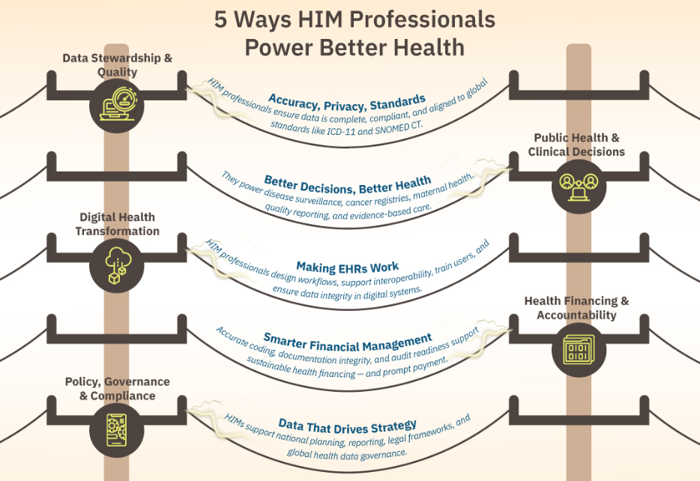
HIM professionals power high-performing health systems
Notes:
HIM professionals work across every level of the health system — from the patient chart to national reporting platforms.
Their impact can be grouped into five core areas, each of which is essential for system performance, equity, and sustainability.
They are the stewards of data quality, the backbone of digital health systems, and key players in financial integrity and policy development.
From helping countries adopt ICD-11, to securing patient privacy, to preparing reimbursement documentation — HIM professionals do the hands-on work that makes data useful.
This is not a back-office role — it’s foundational infrastructure for better healthcare.

Slide 4
Strengthen health systems by elevating the HIM workforce
What’s holding HIM professionals back — and how to unlock their full value
Barrier
Solution
Outdated job titles and classifications Modernize job classifications, role descriptions
Limited workforce development Invest in education, professional development
Not embedded in digital health strategy Integrate HIM in national planning
Inadequate staffing, career pathways Fund and grow the workforce
Unaligned systems and standards Empower HIM professionals to lead
Notes:
Now is the time to invest in HIM professionals — not as an option, but as the foundation of smarter, stronger health systems.
These are some of the most common barriers: outdated job classifications, limited workforce development and career pathways, fragmented systems, inconsistent standards. In many cases, HIM professionals lack a seat at the table when planning digital health strategy, whether for a single health system or a nationwide effort.
Yet every barrier has a solution. IFHIMA stands ready to help, with best practices and lessons learned from around the globe. We can help chart a path to elevate your HIM workforce — and unlock their tremendous value in the process.

Slide 5
4 takeaways
Global health systems can’t succeed on data alone — they need the people who make it usable
HIM professionals ensure health data is accurate, accessible, and aligned with global standards
Their roles are foundational to digital health, financing, public health, and governance
Barriers are solvable — and IFHIMA is ready to support governments, funders, and partners
Notes:
Remember, health systems can’t succeed on data alone. If you’re investing in data, you need to also invest in the people who understand how to make that data usable — and trustworthy.
HIM professionals are the key. Without their leadership, the systems meant to modernize care often create new gaps in data, funding, and trust. HIM professionals must be part of the foundation, not an afterthought.
IFHIMA is uniquely positioned to support governments, funders, and partners — anyone in healthcare who wants to build a stronger, more sustainable system.

Slide 6
Invest in the people who make your data work
“HIM professionals are not just data experts — they are connectors. Their ability to bridge clinical, technical, and administrative systems makes them essential to the success of data-driven healthcare everywhere.”
Learn more:
ifhima.org/global-value-of-him
White paper, global case studies, infographics, other resources
Notes:
Remember, HIM professionals are truly connectors. Let’s talk about how to help strengthen the connections within and between your systems so we can improve care and outcomes for everyone.
Visit our website for the full white paper, including several case studies from around the globe, infographics, and other resources.

Slide 7
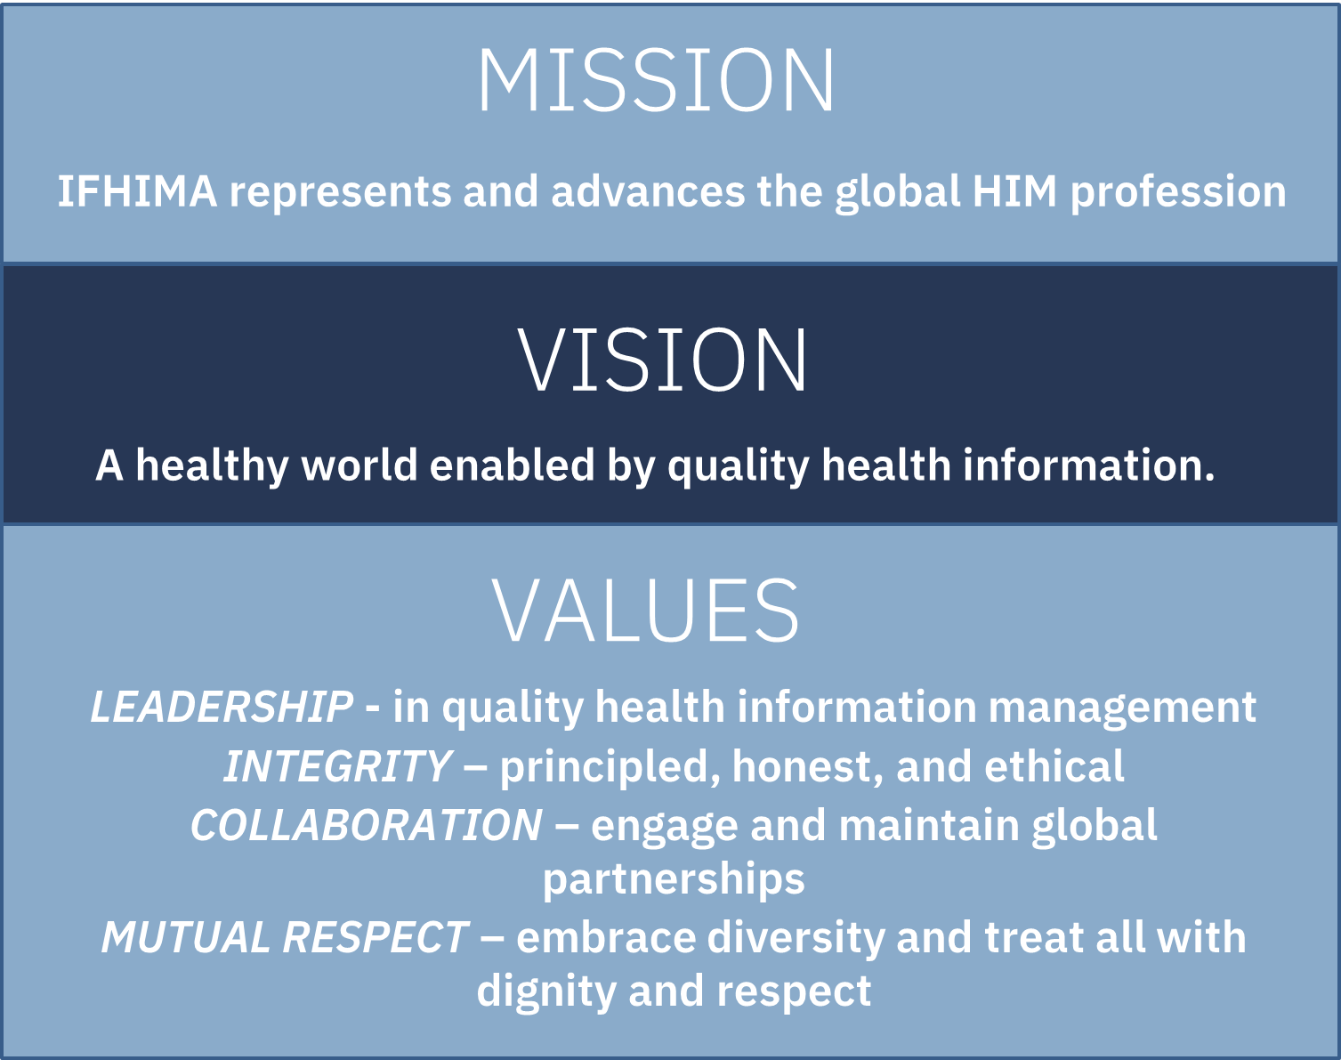
IFHIMA History & Background
Global organization for health Information Management - established in 1968; 58 years strong!!
Long-standing commitment to assist low and lower-middle income countries
Acts as “the global voice” of national HIM associations
NGO status with WHO; 40+ years
Partner with international informatics, International Medical Informatics Association (IMIA)

Slide 8
IFHIMA Resources
Website: www.ifhima.org
Membership: https://ifhima.org/join-ifhima/
Global News Page: https://ifhima.org/publication-resources/global-news/
Linked In: https://www.linkedin.com/company/ifhima/
Digital Health COP: ceccy.akinjide@gmail.com
ICD-11 COP: mbadore@solventum.com
Research COP: evzlambert@txstate.edu
Education COP: jwapola@css.edu

